Slide 1
Data Science & Machine Learning
Courses Enrolled & Learnings

Slide 2
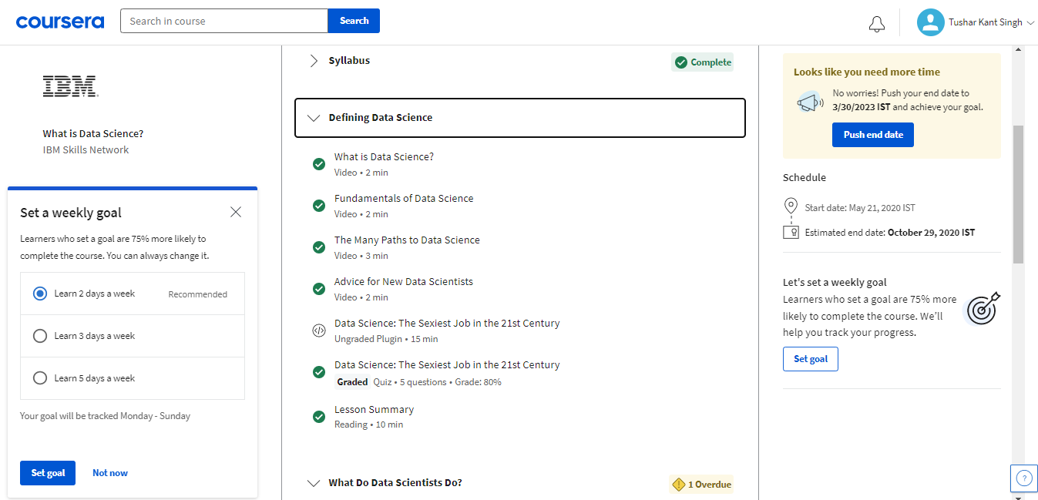
First course of Data Science that sparked a burning desire within me to become data scientist.

Slide 3
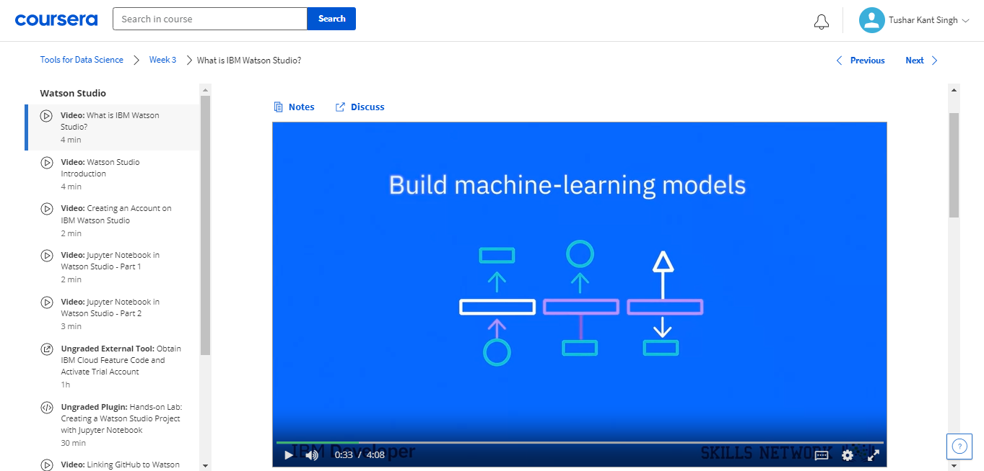
My first interaction with term “Machine Learning Model”

Slide 4
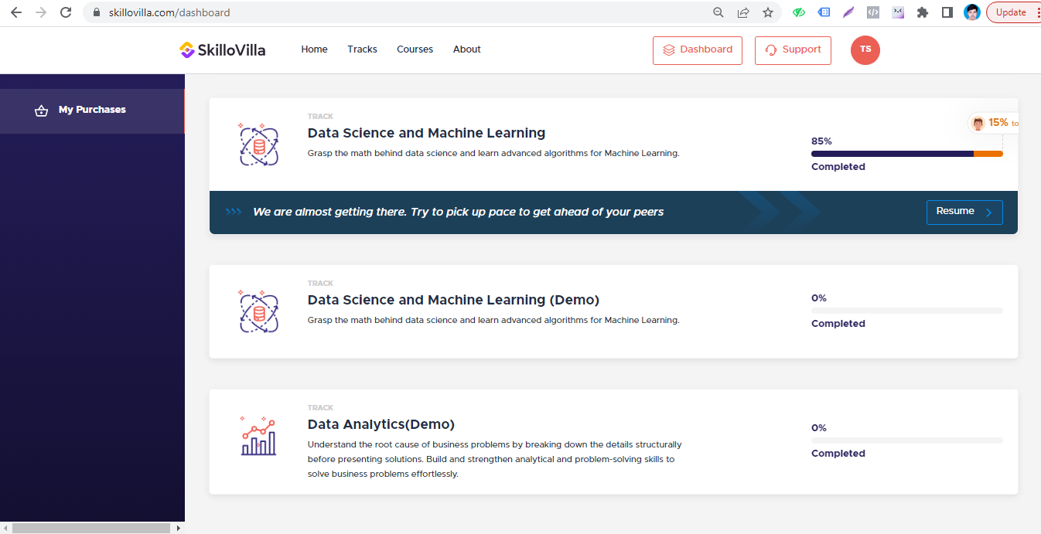
Enrolled in certification course by skillovilla & Completed around 85% of data science of course and done few assignments and capstone projects.

Slide 5
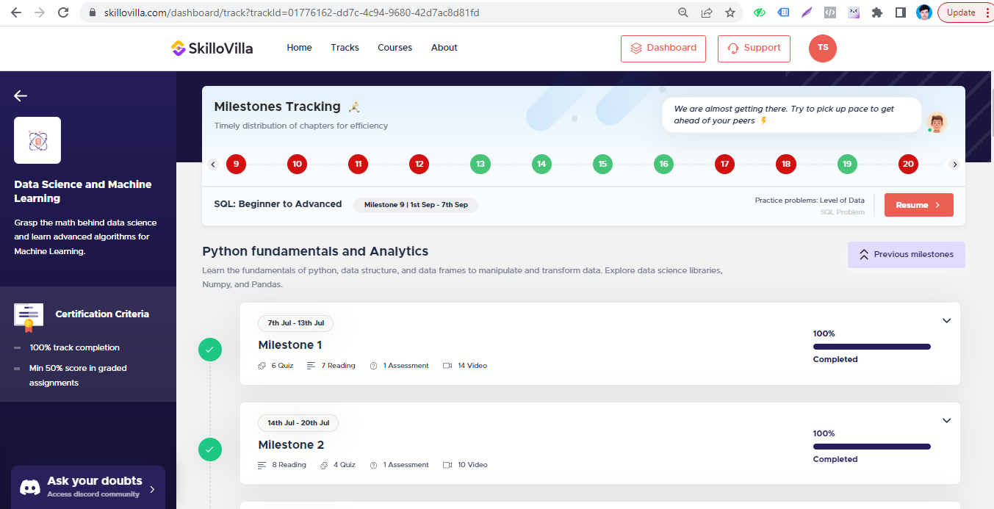
Learned basic Python coding skills.

Slide 6
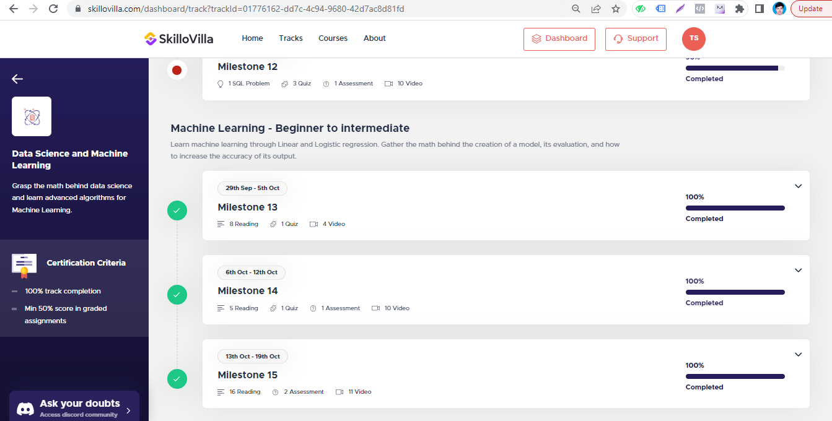
Leaned basic Machine Learning algorithms and build few models.

Slide 7
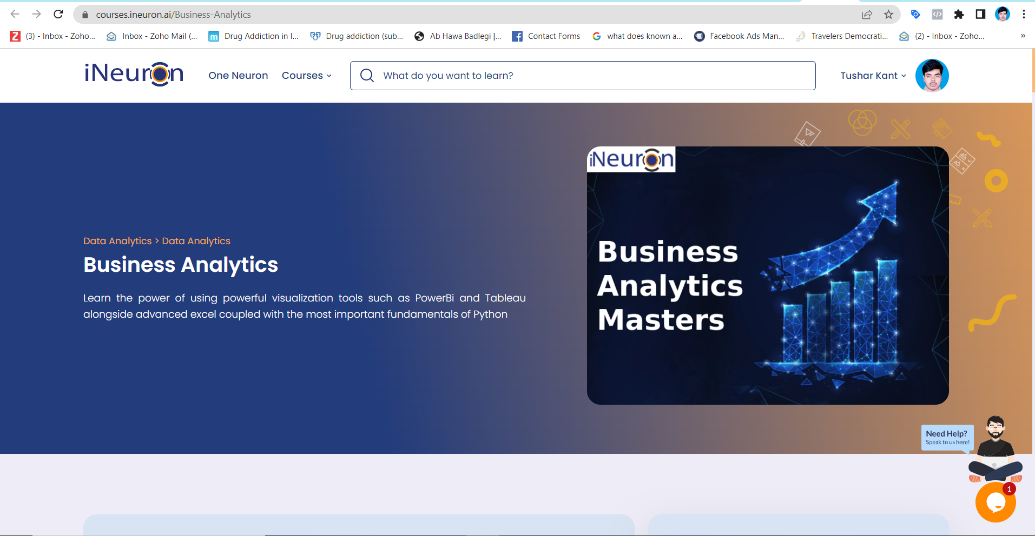
Enrolled in Business Analytics course by iNeuron where got introduced to EDA.

Slide 8
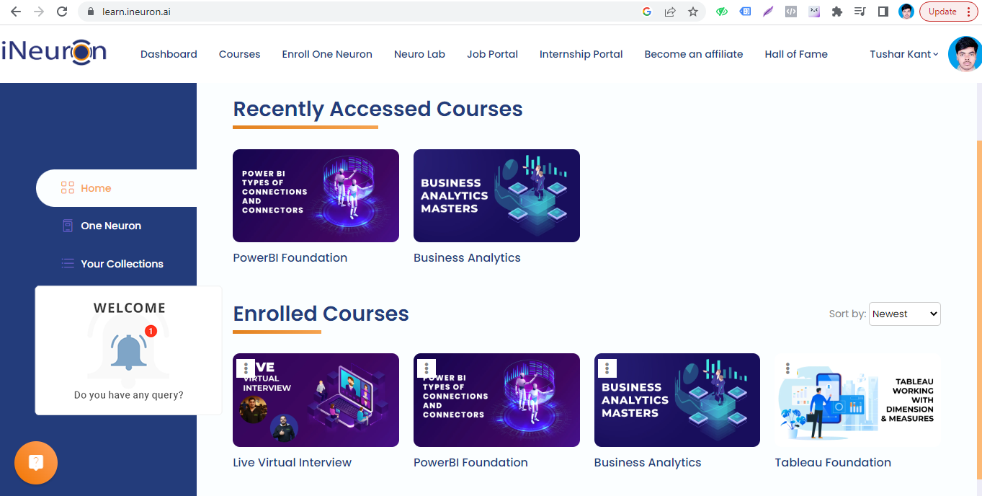
Also joined Power Bi foundation course by iNeuron to learn Data Visualization and build Dashboard & Reports

Slide 9
Digital Marketing Certifications

Slide 10
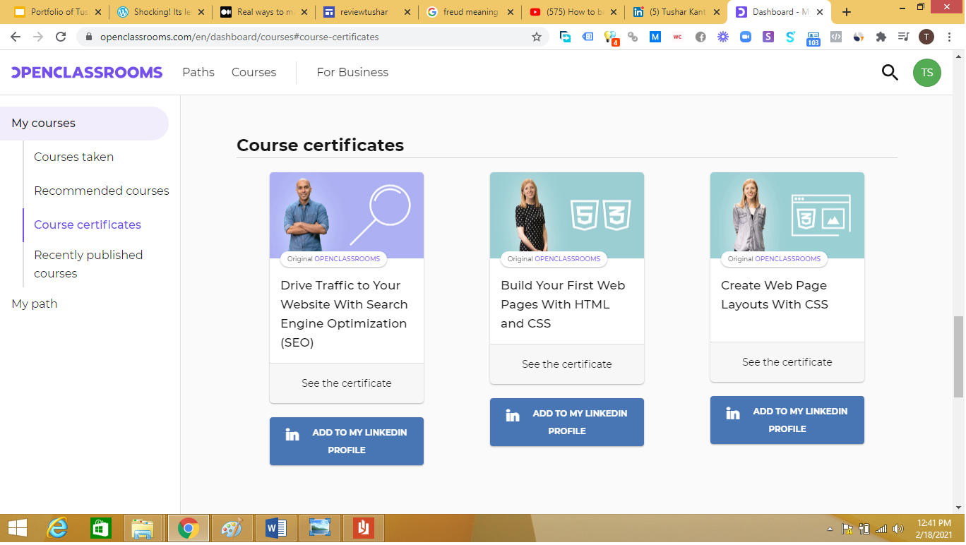
Learned HTML, CSS, & SEO from Openclassrooms.com

Slide 11
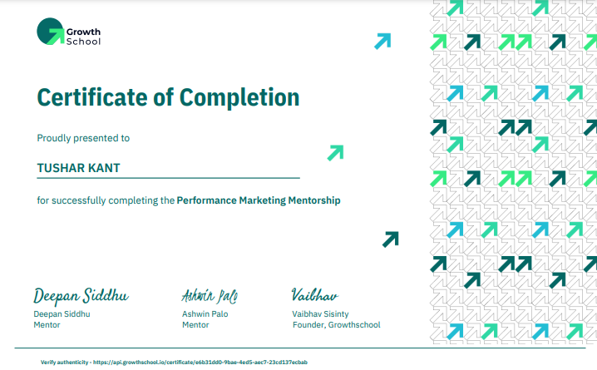
Learned Performance Marketing & got certified by Growth School

Slide 12
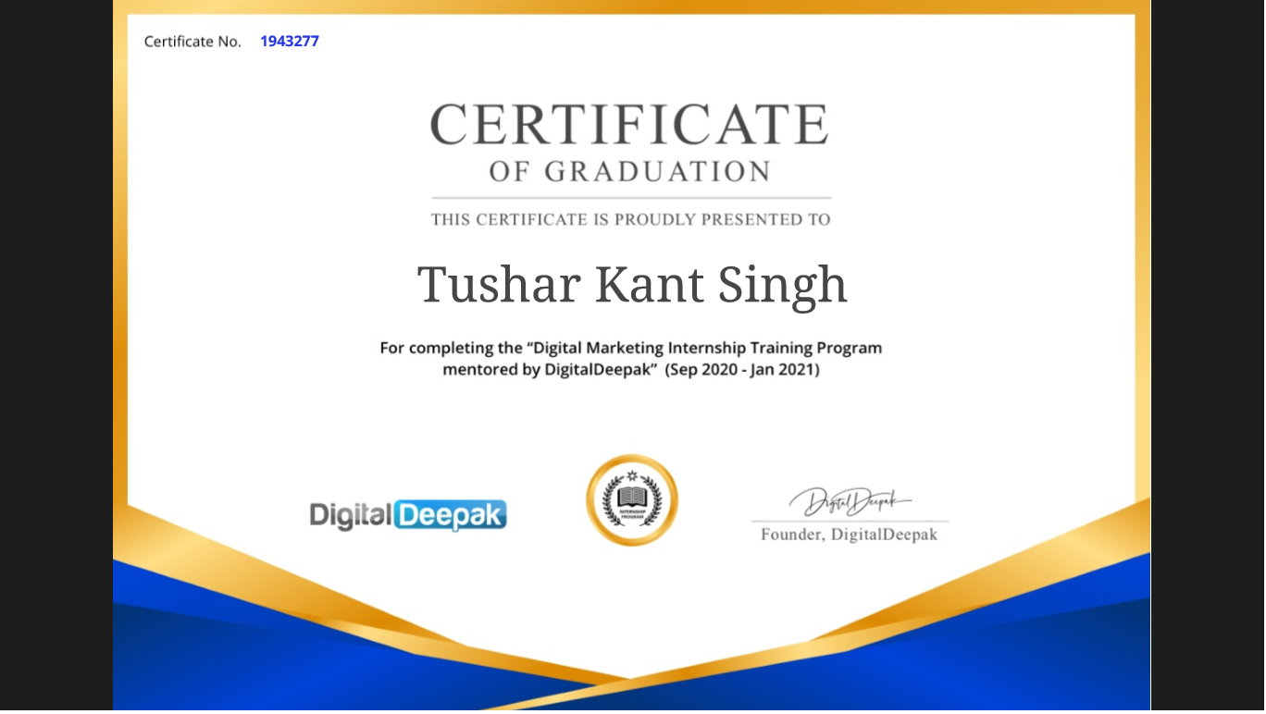
Successfully completed Digital Marketing Internship from PixelTrack by Digital Deepak

Slide 13
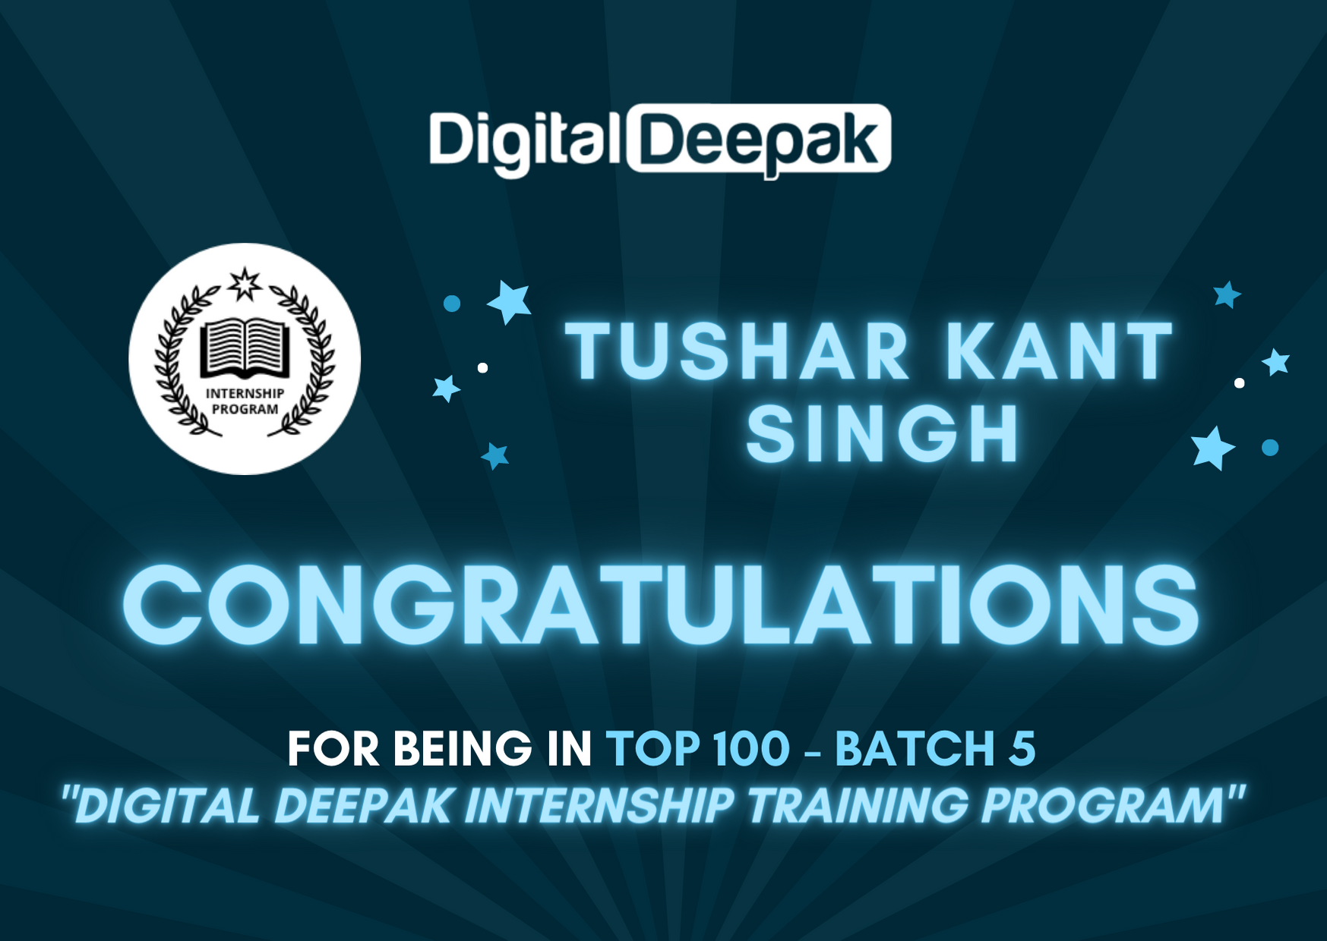
Was among top 100 Trainee in the Training Batch 5

Slide 14
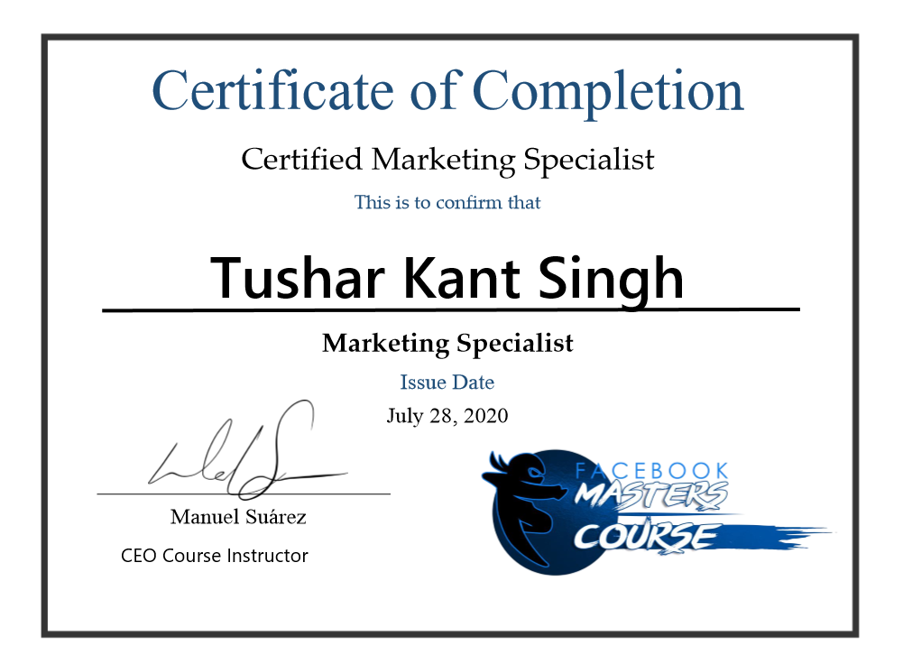
Learned Facebook Ads during lockdown and get certified

Slide 15
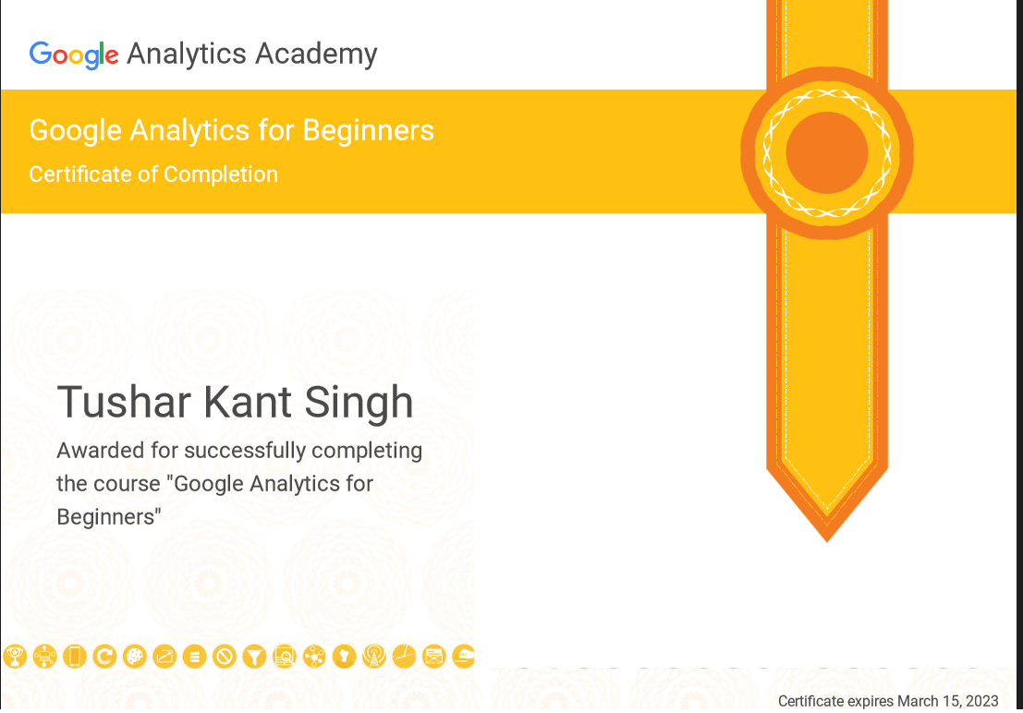
Learned Google Analytics Tools and certified by Google

Slide 16
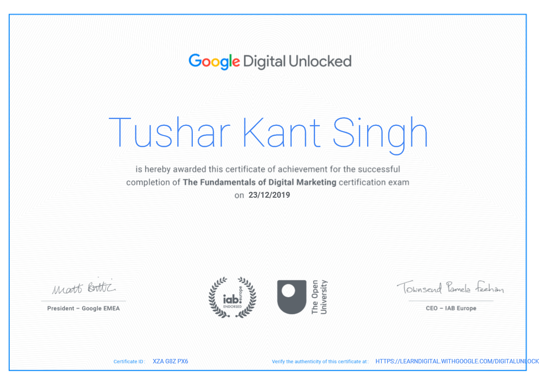
Successfully completed Google Certification of Fundamental of Digital Marketing

Slide 17
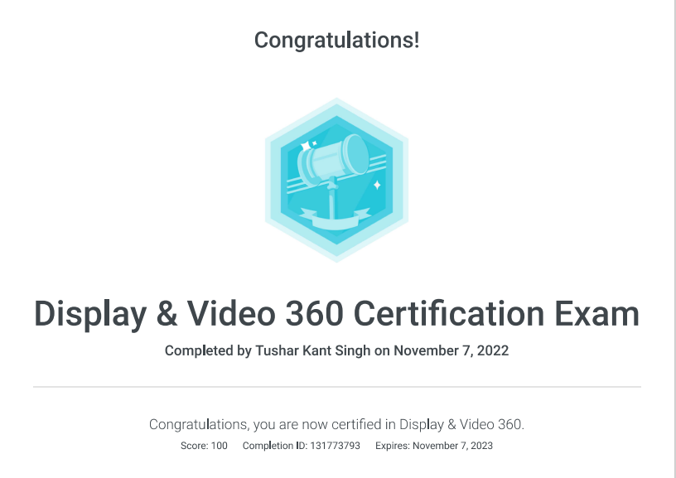
Completed DV 360 Certification from Google

Slide 18
Awards & Appreciation

Slide 19
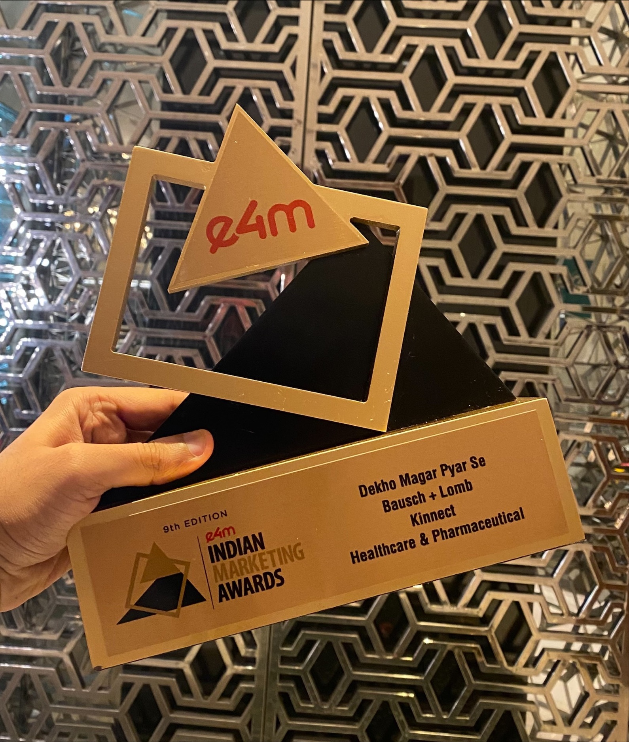
Oue media campaign on DV360 for Bausch+Lomb won Gold at 9th edition of Indian Marketing Awards

Slide 20
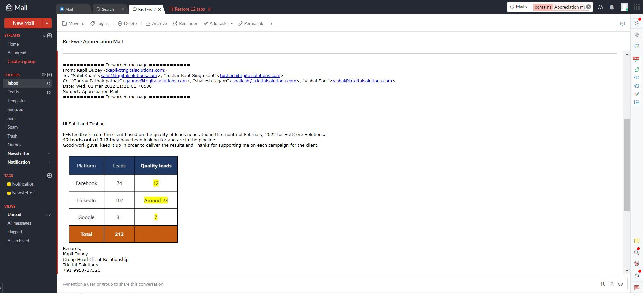
Received Appreciation Mail from US Based ERP solution company for generating quality leads from Fb, Google & LinkedIn.

Slide 21
Thank You So Much...

